Slide 1
IMAGE AUGMENTATION USING GAN
PRESENTED BY
JOEL GIFTSON J

Slide 2
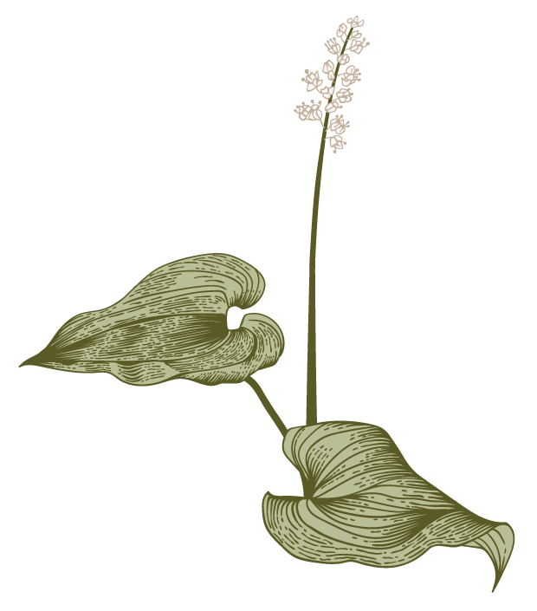
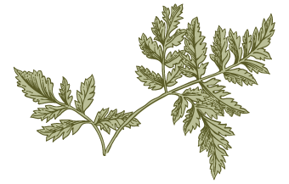
Agenda
A
Problem Statement
Proposed System/Solution
System Development Approach
Algorithm & Deployment
Result
Conclusion

Slide 3
PROBLEM STATEMENT
The project aims to developing a Generative Adversarial Network (GAN)capable of realistic image augmentation pipeline using the MNIST dataset . The MNIST dataset is a widely used benchmark dataset in machine learning and computer vision. It consists of 28x28 grayscale images of handwritten digits (0-9). The goal is to generate augmented versions of the original images to increase the diversity of the training data. This augmentation process helps improve the generalization capability of the machine learning model trained on the dataset.

Slide 4
PROPOSED SOLUTION

Slide 5
GAN Architecture Design:
Design a GAN architecture consisting of a generator and discriminator network using TensorFlow/Keras.
Generator:
Implement a neural network with multiple layers of fully connected and activation layers (e.g.,ReLU).
Experiment with variations in network depth, layer sizes, and normalization techniques (e.g., Batch Normalization).

Slide 6
Discriminator:
Design a neural network with similar architectural choices as the generator but with a binary classification output.
Utilize activation functions such as Leaky ReLU and Sigmoid to introduce non-linearity and produce probability scores.

Slide 7
SYSTEM DEVELOPMENT APPROACH

Slide 8
System requirements:
1.Hardware:
CPU: A multi-core CPU is sufficient for running the training code. However, training GANs can be computationally intensive, so a faster CPU may reduce training time.
Memory (RAM): At least 8GB of RAM is recommended for handling large datasets and training deep neural networks efficiently. Higher RAM capacity may be beneficial for larger batch sizes and complex model architectures.
Internet Connection: It is needed to download the MNIST dataset and access online resources during development.

Slide 9
Software Requirements:
Python: The project is implemented using Python programming language.
TensorFlow/Keras: TensorFlow and its high-level API, Keras, are used for building and training the GAN architecture.
Google Colab: These platforms can be used for interactive development, experimentation, and documentation.
NumPy: It is used for numerical computations and array manipulation.
Matplotlib: It is used for data visualization, including plotting loss curves and displaying generated images.

Slide 10
ALGORITHM & DEPLOYMENT

Slide 11
Data Preparation:
Download the MNIST dataset.
Preprocessed the images by normalizing pixel values to the range[-1, 1].
Generator Network:
Define the generator network architecture using TensorFlow/Keras.
Implemented a neural network with fully connected layers and activation functions (ReLU).
Compiled the generator model.

Slide 12
Discriminator Network:
Designed the discriminator network architecture using TensorFlow/Keras.
Implemented a binary classifier using fully connected layers and activation functions (Leaky ReLU, Sigmoid).
Compiled the discriminator model.

Slide 13
GAN Training:
Define the GAN model by connecting the generator and discriminator networks.
Train the GAN model using adversarial training:
Train the discriminator with real and fake images.
Train the generator to generate original image and several augmented versions of it.
Monitor training progress and adjust hyperparameters as necessary.

Slide 14
Performance Evaluation:
Visualized generated images and compare them with real digital images.
Computed quantitative metrics to assess image quality.
Hyperparameter Tuning:
Conducted hyperparameter tuning experiment to optimize GAN performance.
Select hyperparameters that lead to the best performance based on evaluation metrics.
Deployment:
The GAN model and associated code are deployed into a GitHub repository.
Included instructions for setting up the environment and running the code.

Slide 15
RESULT

Slide 16
The provided code loads the MNIST dataset and applies various augmentation techniques using the ImageDataGenerator class from Keras. It then displays the original image and several augmented versions of it.
Here's the result:
The original image from the MNIST dataset is displayed.
Five augmented versions of the original image are displayed, each with different augmentation transformations applied, such as rotation, width and height shifting, zooming, and horizontal flipping.

Slide 17
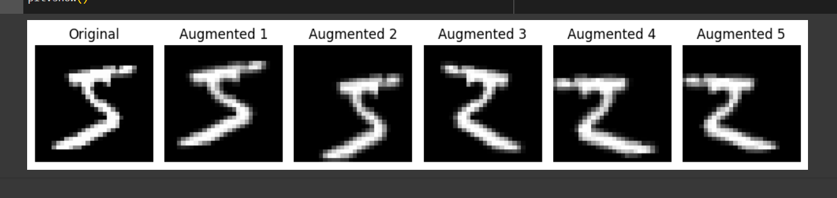
RESULT

Slide 18
CONCLUSION
The project demonstrates the effectiveness of GANs in image augmentation and opportunities in training and deploying generative models. Moving forward, further research and experimentations will continue to push the boundaries of generative modeling and its practical applications.

Slide 19
GitHub Link:
https://github.com/Giftsonj17/Naan_Mudhalvan_Generative-AI.git

